Slide 1

Introduction to IaC
Getting Started with Terraform

Slide 2
Goals
By the end of this course, you will be able to:
Apply IaC principles using a tool called Terraform
Write a configuration file in HCL (Hashicorp Configuration Language)
Provision a simple system on Google Cloud Platform
Make and apply changes to your infrastructural requirements
Release compute resources associated with your configuration

Slide 3




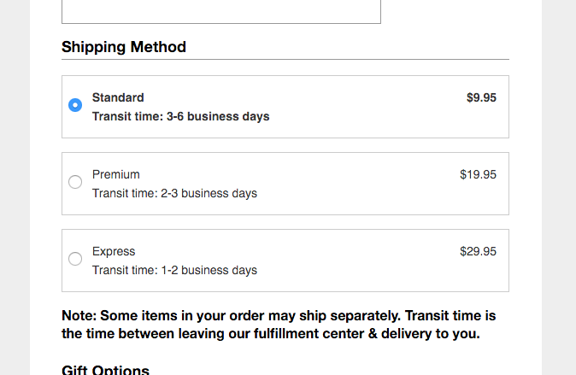





Introduction
Traditionally, infrastructure management involved acquiring, installing, and maintaining hardware equipment
The proliferation of cloud compute options introduced many benefits over this traditional model, but many challenged remained
Notes:
Once upon a time, a typical company hosted their own datacenter or lab to maintain hardware equipment to satisfy their organization’s computing requirements.
Hardware was costly and often time-consuming to acquire
Typically required an expensive facility to safely host hardware
Required a team of engineers to maintain
Prone to failure
The introduction of cloud compute platforms solved the physical aspects of this problem. Companies no longer need to maintain their own hardware, but rather they can rent compute resources that are hosted online and accessible from anywhere in the world, thereby opening up new possibilities.
While this revolution solved many problems, it introduced some new challenges.
Setting up resources is a manually intensive process that is prone to human error. How can we quickly reproduce complex systems in a safe and consistent way?
Furthermore, how can we easily deploy multiple instances of a particular system, to satisfy a complete devops process within our organization?
How do we manage changes to our requirements after the system or systems have been set up?
While cloud computing environments are said to be elastic, they’re not as elastic as we’d like to think. We continue to pay for compute resource we’ve allocated, even during the times we’re not actively using them. What do we do with compute resources during the times when we don’t need them?
What happens if and when our in-house expert leaves the company?

Slide 4

IaC Overview
Infrastructure as Code (IaC) refers to:
Describing infrastructure through the use of machine-readable files
[
{
“type”: “compute”,
“image”: “projects/…”,
“cpus”: “4”,
“mem”: “4GB”,
“region”: “us-east”,
“zone”: “a”
},
{
“type”: “network”,
“config”: “dhcp”,
“cidr”: 10.0.0.0/128”,
}
]
Delegating management to systems can can read and act on these files
Notes:
Infrastructure as Code (IaC) refers to the management of cloud infrastructure (which can refer to virtual machine instances, disk images, network firewall rules, and any other resources related to a cloud compute environment) through the use of configuration files and automation systems that read and act upon those files, rather than through the use of interactive tools to manage such infrastructure directly or, worse yet, having to acquire and manage hardware resources directly.

Slide 5
Value of IaC
Benefits of employing IaC include:
Speed
Efficiency
Consistency
Cost
Reduction of risk
Notes:
Speed – with IaC, setup of complex systems can be automated by a script. This setup process can include provisioning VMs, data processing clusters, the connections between instances and the outside world, storage systems, load balancers, and even databases and tables. Essentially, any resource that can be supplied by your cloud compute platform.
Consistency – configuring complex systems requires careful attention to detail, and the possibility of human error can lead to problems that may be difficult to debug down the road. IaC ensures consistency time after time, also making it easy to configure multiple instances of your systems to satisfy the devops requirements of your organization.
Risk mitigation – IaC reduces risk in many ways. For one - In traditional forms of system configuration, the knowledge was often tribal and could leave the company at any moment. With IaC, system configuration is well defined and documented, making it much easier for successor to assume control if key individuals leave your organization. Another way risk is reduced is through automated change management. Settings can be updated as needed, or new integrations can be introduced, and the IaC system will deal with and apply these changes in a correct and seamless manner.
All of these desirable characteristics lead to tangible benefits to your business; namely
Efficiency – time is saved in provisioning infrastructure. Precious human resources that were previously occupied managing infrastructure are now available to focus on adding value elsewhere. Duplicate environments can be created quickly for development and testing purposes, streamlining your organizations devops processes
Cost savings – the need to pay engineers to manage infrastructure is substantially reduced. Furthermore, IaC can be employed to release compute resources when not needed, all impacting the bottom line in a positive way.

Slide 6
Provisioning vs Configuration Management
IaC
Provisioning
Configuration management
Notes:
Two important concepts to be aware of, when defining your requirements and picking an IaC tool to satisfy those requirements, is the notion of provisioning vs configuration management. These are two separate subdomains of the overall IaC space. Tools that implement either of these can all be considered to be IaC tools if they read configuration files and effect a set of actions on your infrastructure based on the instructions contained within those files – but they each focus on a subset of the bigger picture.
Provisioning refers to the process of orchestrating infrastructural elements like VM instances, disk images, databases, networks, load balancers, and more. Examples of tools that provision include Terraform, AWS CloudFormation, Google Cloud Deployment Manager, and Azure Resource Manager.
Configuration management refers to customizing the environment on existing servers – enabling services, installing software, enabling users – all these tasks fall into the realm of configuration management. Popular examples include Packer, Puppet, Chef, and Ansible.
Some tools can do both. For example, Terraform provides basic hooks for performing configuration of the instances it starts. But its main focus and strength relies on its ability to maintain a consistent infrastructural state, as well as intelligently managing changes to that state.

Slide 7
Terraform
Open source provisioning tool developed by Hashicorp
Works across different cloud platforms and services
Employs a declarative approach to configuration management
resource "google_compute_instance" “foo" {
name = "test"
machine_type = "n1-standard-1"
zone = "us-central1-a"
boot_disk {
initialize_params {
image = "debian-cloud/debian-9"
}
}
network_interface {
network = "default"
access_config {
// Ephemeral IP
}
}
}
"n1-standard-1n1-standard-2"
Notes:
Terraform is an open-source provisioning tool that, unlike many predominant tools in the space, works with various different cloud providers and services. For example, in one single configuration Terraform could be used to provision a compute instance on AWS as well as a Dataproc cluster on Google Cloud Platform, while leveraging domain name services provided by DNSSimple.
Another important distinction of Terraform is its declarative approach to configuration management. This means that your configuration files are specifying (or declaring) the desired end state of your infrastructure. When you apply your configuration, Terraform will identify the deltas between the current and desired states, and build a plan that will get it there. Some other tools out there employ a procedural approach to configuration management, which requires you to codify in your configuration files how to get to the desired state – while this approach provides additional flexibility, it also makes writing configuration scripts a lot more complex. Terraform’s format is so simple in fact, that it employs a JSON-like scripting language called HCL (which stands for Hashicorp Configuration Language). It also supports JSON as an input language.
The benefits of Terraform’s declarative approach become apparent when it comes time to make changes to your infrastructure. In this case, you simply need to amend your configuration files to reflect the new desired state of your configuration, and Terraform will figure out how to make that happen when you apply those changes.
In an example to illustrate this principle, we have an excerpt from a configuration (written in HCL) that has provisioned a single-core compute instance and a database. Over time, it has become apparent that the compute instance is not scaling well to current compute needs. So, the solution is to amend the file describing the compute instance, increasing the number of virtual cores to two. On applying this change, Terraform will only destroy and recreate the elements needed to satisfy the change – in this case the compute instance – while leaving the provisioned database intact.

Slide 8
Lab
In the labs accompanying this training, you will:
Install Terraform in your development environment
Write a configuration script that will provision a compute instance on Google Compute Engine
Apply changes to your configuration
Delete resources allocated during the lab
Follow the link provided in the lab to create a free Google Cloud Platform trial account (required).
Notes:
A lab is included in this training in which you will apply the material covered. Specifically, you will:
Install Terraform into a google cloud shell environment
Write a simple configuration script that will provision a small compute instance on Google Cloud Platform
Apply this configuration script to provision an instance
Make changes to the configuration and apply those changes
Clean up any resources allocated during this lab
The lab will take approximately 30 minutes to complete, and will require a Google Cloud account. If you don’t already have one, follow the link provided to create a free trial account.

Slide 9
The Least You Should Know
IaC automates the process of provisioning and/or configuring resources in a cloud compute environment
Terraform is an open source tool that employs a declarative approach to provisioning resources across a variety of cloud providers and services
Terraform simplifies the creation, modification, and destruction of allocated resources while promoting a collaborative environment
Notes:
Before completing this training, let’s review what was covered.
IaC (or Infrastructure as Code) provides a framework for managing resources in a cloud compute environment in an automated fashion. Tools in this space typically either focus on provisioning (that is, create new resources) or configuration (that is, customizing existing resources)
Terraform is an example of a provisioning tool that is open source. It employs a simple, declarative file format for describing the desired state of a system. Working across a variety of cloud providers and services, it determines how to achieve the desired state.
Through its simple configuration format and ability to share files and state information, Terraform promotes a collaborative atmosphere while simplifying the task of managing your infrastructure, particularly as your infrastructural needs change over time.

